Slide 1
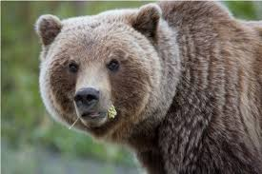
Data Migration from Excel: A Brief Introduction to Arctos
Dusty McDonald, UAM
Carla Cicero, MVZ
iDigBio Workshop
Vertebrate Digitization II
Berkeley, California
4-6 April 2016

Slide 2
What Is Arctos?
Collection Information Management System for managing data on:
Specimens
Basic “label data”
Usage: Projects → Loans → Publications → Genbank
Interactions: host/parasite, predator/prey, parent/offspring…
Agents
People
Agencies
Groups
Places and Events
Descriptive
Spatial
Temporal
Taxonomies
Media
Other Stuff
Notes:
First we need to talk briefly about what Arctos is, that’s important for the rest of this presentation.
Arctos is at the core a specimen management system, and has a place for all the normal “label data.” Additionally Arctos has the capacity to track things like usage, and to interact with various online resources.
Arctos is deeply normalized – that means we never say the same thing twice, we just link to related data. That also means that Arctos has no pre-defined viewpoints – all of the “nodes” such as agents or places can stand alone, and the objects in them just happen to refer to specimens.
That doesn’t stop at any collection, nor at Arctos itself – hosts and parasites, local taxonomy and GlobalNames, and specimens and GenBank can all be viewed as parts of the same things.
Additionally, normalization means the data model can adapt to the data; cultural, paleontological, and natural history collections of wildly variable complexity all live in the same tables and have access to the same resources, and we can accommodate new types of data without changing the model or code.

Slide 3
Arctos is…
Powerful Oracle Relational Database
Comprehensive set of web applications
Interaction with external services
Community
Notes:
At it’s core, Arctos is a database of around about 60 highly-interactive tables. All business rules live at the database level, so it’s possible to hook up various applications or give users SQL access without worrying about them getting lost or breaking anything.
Arctos also includes a comprehensive user interface which provides the capacity to do just about anything anyone’s ever wanted to do to museum specimen data, singly or in batches. The same UI simply logs in as read-only users to provide public access, and we can customize those users to see everything or to be locked into any number of collections, which provides for “portals” such as all Alaskan insect collections.
Behind the scenes, Arctos also runs lots of services which provide for things like email notifications of loans coming due or permits expiring, automated georeferencing through Google’s services, and reciprocal linkouts from GenBank to specimen records.
Perhaps most importantly, Arctos is a community. Decisions regarding development and authority data are made as a group. Functionality we create for insects is used by cultural collections, and field notes digitized for parasite specimens are available from bird and mammal records. Questions regarding everything from best practices for recording locality data to where to purchase barcodes are addressed by the community. Despite popular opinion, we find that ornithologists and botanists do largely the same things, they just don’t commonly talk to each other. When they do talk to each other, efficiencies emerge – things get easier and better for everyone. No one group could have ever designed Arctos; it is a synthesis of the best practices of a very broad community of users.

Slide 4
Two Key Features
Normalization
Eliminate redundancy
Standardization
Don’t say the same thing multiple ways
Notes:
Arctos can freely interact with the online ecosystem of things related to specimens, or related to things related to specimens, because our data are extremely predictable.
We do that by standardization, and we standardize through normalization, which is a lack of redundancy. It’s impossible to do the same thing multiple ways if you only do it once, which leads to very predictable data.

Slide 5
Label Data Are Core!
For every standardized term, there is an accompanying verbatim, e.g.
Verbatim data have structure too
Remarks field for every object
Datatype Attributes
Taxonomy | ← → | Identification
Geography | ← → | Verbatim Locality
Events | ← → | Verbatim Date
Agents | ← → | Verbatim Collectors
Notes:
Curators want to record “verbatim data,” and Arctos accommodates this in addition to formalized searchable data. For every standardized field, there’s an accompanying verbatim – usually lots of them.
The standardization doesn’t stop at the data themselves, we also standardize the organization of free-text data. While the data themselves aren’t very searchable – we can’t control what’s typed into a uncontrolled field – the existence of certain types of data is in itself powerful.

Slide 6
Datatype
Free text
“ad.”
“skull ossified”
“sngl-layrd sk.”
Categorical
young adult
adult
Numeric
12 years
3 days
Notes:
Attributes is a good place to expand on this. We store several types of data in one structure, conditionally enforcing datatype and vocabulary. For example, there are three ways of specifying age in Arctos – free text, categorical, and number plus units.
So while we may not try to predict all of the ways in which a user has tried to say adult, we can find the data which might have those data by the existence of the attribute. I should point out that all examples in this presentation are actual data, and that I have no idea what a South Korean (SK) snuggle-lanyard is.
Adding vocabulary control gets us to categorical age data – instead of whatever someone wants to type, values are limited to a finite list. That’s still about 70 values – insects are complicated – but it’s a manageable number. Attributes also contains a determiner and method – “adult” may mean different things in different taxa or for different purposes (sexual vs. osteological vs. plumage vs. time), but these data are often not recorded.
Even more precise are numerical values (with units). These remove all ambiguity, allowing the user – rahter than curator or collector - to define adulthood however they want. And again the seffective structure is dynamic and data-driven – Arctos contains seals with multiple numeric age determinations resulting from examining cementum layers in various teeth, for example.

Slide 7
Goals of Digitization
Digitization should allow the data to DO STUFF
No pre-defined boundaries
Interact with other data
Be discoverable
Add value to physical specimens
Notes:
Now I’d like to very briefly diverge into why we digitize, and the short answer is to get more from the data – to use it to get more from the specimens and the collection, including things like report generation, error detection, identifying related material, and providing trustworthy links from publications to vouchers. If the data can’t do anything useful, who cares if tick mark or 53 is recorded as a collector?
First, there’s a place for everything. Our model fits whatever data shows up, so it’s never be necessary to mix comments in with numeric data or identifications in with taxonomy, or to record a verbatim string alongside authoritative data.
Second, Arctos is very interactive – our data are exposed directly to users, through various portals and search engines, and to other data. Transcription mistakes are discoverable when a mouse parasite is attributed to a squirrel, when a sequence in GenBank isn’t as expected, or when an asserted geography doesn’t match that under the coordinates, for example.
That leads to discoverability. There are very many ways to get at data in Arctos, and those pathways leads to more interactions which leads to even better data.
All of this together leads to more value in the collections themselves. Specimens are examined and cited, and identifications become linked to publications and other supporting evidence, for example.
The goal is always to create data which can do something.

Slide 8
Tools
No person, no matter how meticulous, can consistently enter data at any useful scale
Tools to enforce consistency are critical
Pick, don’t spell
Enforce Rules on Datatype
Latitude can’t be > 90°
“Dates” which are not (Feb 31)
Non-numeric data with units
Arbitrary arrangement of terms (geography, higher taxonomy)
Notes:
Reaching those goals requires consistent, correctly-typed data, and humans simply aren’t capable of generating that at any useful scale without some help. Typos happen, numbers are accidentally re-used, there really are two “Carolyn Parkers” collecting plants in Alaska, and collectors write strange things on labels. We need tools to turn strings into data objects, and we need user interfaces which force us to specify THAT Carolyn, to reject creative spellings of taxa, to ensure a collector isn’t trying to rewrite the calendar, and to represent coordinates on maps so that we can avoid creating pelagic chipmunks.

Slide 9
The Excel Challenge
How do you migrate non-standardized verbatim values to standardized, structured data for easy discovery?
Let’s look at Agents (People) as an example of how this works in Arctos…
Notes:
So, that leads us to what we want. But that’s often not what we get.

Slide 10
The View from Excel
C. L. Parker
Carolyn Parker, Page Specner, & Stacy Studebaker
Carolyn Parker, Page Spencer, & Stacy Studebaker
Carolyn Parker, Page Spencer, Stacy Studebaker
Carolyn Parker, Page Spenver, & Stacy Studebaker
Carophy Parker, Page Spencer, & Stacy Studebaker
Carophyn Parker, Page Spencer & Stacy Studebaker
Stacy Studebaker & Carolyn Parker
Stacy Studebaker and Carolyn Parker
Stacy Studebaker & Caroyln Parker
Stacy Studebaker & Caryolyn Parker
Stacy Studebaker, Carolyn Parker
`
53
Notes:
These are some of the distinct agents from a dataset of about 15,000 records which we imported to Arctos. The data were entered from imaged labels into a flat-structure database which seems to provide no contols. It’s not clear what we can get from these data, or how they’re more useful than the specimen labels from which they were digitized, and the obvious transcription errors here would lead me to doubt the rest of the data. Unless you happen to know all of the ways in which Carolyn’s name has been spelled you can’t ever find all the specimens that were collected by Carolyn.

Slide 11
The View from Arctos: One Agent
Agent Names:
Carolyn L. Parker (preferred)
Carolyn Parker (aka)
carolyn (login)
C. L. Parker (initials plus last)
Parker (last name)
L. (middle name)
Parker, C. L. (last plus initials)
Carolyn (first name)
CLP (initials)
Parker, Carolyn L. (aka)
Notes:
Arctos contains one agent record for a person, company, organization, etc. All may have any number of names. I won’t show it here, but agents also have addresses such as shipping labels and emails, and of course like everywhere else used data are protected – it’s not possible to change an address to which a loan has been shipped, for example.

Slide 12
Agent Relationships
Carolyn L. Parker is
Not the same as Carolyn R. Parker
Harold Parker is sibling of
C. L. Parker is bad duplicate of
Notes:
Relationships to other agents provide disambiguation. How many of the free-text “Carolyn Parker” strings actually refer to Carolyn R. instead of Carolyn L.?

Slide 13
Agent Activity
Collected or Prepared specimens:
1 UAM:EH specimens
7 UAM:Alg specimens
1406 KWP:Ento specimens
1 UAM:Bird specimens
1 UAM:Ento specimens
17001 UAM:Herb specimens
9 UAM:Mamm specimens
255 UAMb:Herb specimens
Projects
U.S. Forest Service-Alaska Region
Yupik Ethnobotany Project
Three Parameters Plus,Inc.-2012 Annex Creek Botanical Survey
Arctic Alaska Network Inventory and Monitoring vascular plant survey.
Publications Ihsan Ali Al-Shehbaz, Jason R. Grant, Robert Lipkin, David F. Murray, Carolyn Parker. 2007. Parrya nauruaq (Brassicaceae), a new species from Alaska. Novon 17:275-278.
9 citations
Matthew J. Wooller, Grant D. Zazula, Mary Edwards, Duane G. Froese, Carolyn Parker, Bruce Bennett. . Stable carbon isotope compositions of eastern Beringian grasses and sedges: Investigating their potential as paleoenvironmental indicators. Acta Chiropterologica 39(2):318-331.
0 citations
Matthew J. Wooller, Grant D. Zazula, Mary Edwards, Duane G. Froese, Carolyn Parker, Bruce Bennett. 2007. Stable carbon isotope compositions of eastern Beringian grasses and sedges: Investigating their potential as paleoenvironmental indicators. Arctic, Antarctic, and Alpine Research 39(2):318-331.
140 citations
Notes:
Links from agent records to related “nodes” provide context for the agent-entity. Along with an agent summary, this is an important diagnostic tool – a specimen collected by Carolyn in 1800 either has a bad date or wasn’t really collected by our Carolyn, for example. That is, having good data leads us to other data, which reinforces the quality of the original.

Slide 14
How Do We Get There? The Arctos Bulkloader
All Arctos data entry goes through the Bulkloader
Data Entry screen, small imports by Curators, new collections, everything!
Giant flattened table, accepts CSV
Arctos provides a builder to create templates
Can write to other bulkloaders
New collection imports tested to ~400K specimens, no apparent limitations
Notes:
The specimen bulkloader is essentially a set of scripts which accept flattened data from a big excel-like file and either parse them out into Arctos proper.
The bulkloader table currently contains 288 columns, which is big enough to handle about 99% of our initial data entry requirements and small enough to be somewhat usable.
There’s a bulkloader builder which lets you build customized templates including only what you need for a project, and the data entry screen will write to other bulkloaders, so if you only have one part you don’t have to look a a bunch of empty columns, and if you have 30 parts there’s a pathway for that too.
And I should mention that “a part” is 7 bulkloader colums - part name, condition, barcode,label,lot count, disposition, remark, and other complex data – attributes, geology, etc. – are similar.
Early versions of the bulkloader were relational, and that didn’t really work from a usability standpoint – people simply do not think relationally, but have no problem with part_condition_12.
There are probably limitations on the number of records the bulkloader will handle, but we haven’t found them yet.

Slide 15
Data Entry
Writes to Arctos Bulkloader
Can pull data (eg, “seed” parasite record with host information)
Can write to related tables (extra collectors, attributes, etc.)
Can selectively carry data from previous record
Fully customizable by collection type, collection, user
API-based
Notes:
Many specimens are entered through the built-in data entry UI.
Data Entry is interactive and connected; it limits values to authorities, can pull data from related records and services such as geolocate, and has a mechanism for dealing with data which doesn’t fit in the core structre.
The screen can be customized at several levels, and is based on an API so its technically trivial to create custom data entry applications. We’ve done so for the rapid digitization projects involving plants and paleo collections, for example.

Slide 16
Pre-Bulkloader
Cleans data based on structure of bulkloader
Extracts unique values of controlled data
Creates lookup files
Repatriates cleaned data
Pushes to bulkloader
Notes:
Instead of loading data directly to the bulkloader, there’s an option to send the data first to a pre-bulkloader, which takes data of the bulkloader STRUCTURE regardless of values. The pre-bulkloader is basically a refinement of the migration scripts that we’ve developed over time, wrapped up in a very simple user interface.
It’s important to stress that this app has only become available as we’ve put effort into standardizing our “authority” data – it’s taken us a long time and a lot of work to get to the point where we have exactly one way of saying Alameda County, California, and without that underlying consistency - without unambiguous authority files – this application could not exist.
As I’ve mentioned the bulkloader is denormalized – Agent “53” may occur in dozens of fields across thousands of records, and the string 53 may do the same. The pre-bulkloader introduces normalization behind the scenes – it condenses all occurrences of the agent – and other stuff – into a single string, making it easy for people to deal with the corrections.
Once lookups are created, either by using the many Arctos tools or by simply typing corrections - the pre-bulkloader denormalizes those data back into the flattened structure where the normal procedures can load htem as specime data.
The end result is that instead of dealing with dozens or hundreds of columns and thousands of rows, people usually end up dealing with a few two-column spreadsheets containing a very small fraction of the total records. This drastically decreses workload, and provides an environment where recognizing errors is simple.

Slide 17
Pre-Bulkloader
Relies on a series of Pulls from existing data, e.g.
Agents
Name variations (Bob ← → Robert)
Non-preferred (maiden/married, AKA, native character sets [e.g., Cyrillic])
Geography
Standardized descriptive data (“Russia”)
Less-standardized “search terms” (“Росси́я”, “Russian Federation,” “Росси́йская Федера́ция”)
Wikipedia
Notes:
Nothing in Arctos lives in a vacuum, and the pre-bulkloader and associated tools is no exception. Once unique values of data strings have been extracted, they can be corrected through a series of tools which draw from other Arctos data, Arctos “metadata”, and external resources.
The agent loader for example knows that Bob and Robert are often variations of the same thing, and can use that knowledge to find matching data even in the case of very different strings.
The geography loader uses existing Arctos data and a “search term” table that we’ve added to capture alternate or non-current terminology. The geography itself is drawn from and linked to Wikipedia, so we have several layers of validation happening, and users finding the specimens will ultimately be able to get some help from wikipedia in understanding what we mean by Russia.

Slide 18
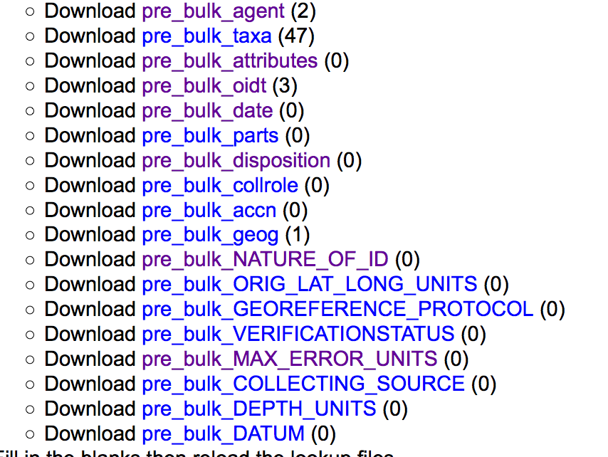
Pre-Bulkloader: Demo
Data for new collection (~3K eggs)
Assembled into Bulkloader format by collection
Upload to Pre-Bulkloader, set to check, get list of unrecognized controlled data
Notes:
I’ll run through a few screenshot from the pre-bulkloader, taken during the import of an exceptionally clean and very small new collection. The data were transformed into the bulkloader format by the collection. And at this point the scripts have run to find unique ambiguous values. I’m not sure if you can see the screenshot, but there are two new agents, 47 new taxa, and all Attributes are acceptable.

Slide 19
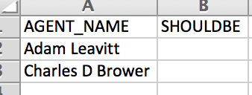
Download a table, fill in the blanks:
Notes:
Two Agents have fallen out. I could feed these to the agent cleaning scripts and in this case they’d find good matches, but with such a small number of potential problems it’s easier to just use the Arctos forms.

Slide 20
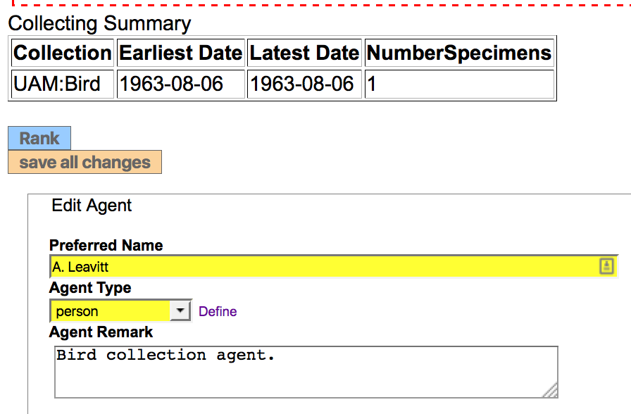
Check Arctos for existing matches
Notes:
There is a partial match, and activity and comments strongly suggest that this is the agent we’re looking for.

Slide 21
Looks promising, add a name and remove the “missing” agent from the pre-bulkload lookup
New record will load, existing data improved by additional context
Notes:
This sort of connected ecosystem not only improves the incoming data, but also very often adds to existing data. In this case we have a better name for an agent who has collected for multiple collections. We simply add the name variant to the existing agent record and delete it from the lookup tables as no correction is necessary.

Slide 22
Mis-match (due to punctuation)
corrected in the lookup
Notes:
The other problem is a simple formatting mismatch, so we add a correction to the lookup table and feed it back to the pre-bulkloader.

Slide 23
Re-upload lookup files
Results are pushed to all flattened fields
Collectors
Attribute determiners
Event determiners
Etc.
Notes:
We don’t need to worry about where they mismatch occurred – collectors, attribute determiners, identifiers, and all other agents (there are about 30 in the core bulkloader) are corrected from the lookup data.

Slide 24
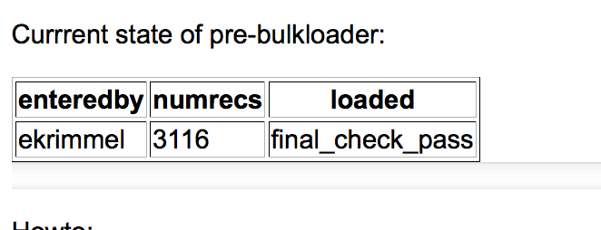
Cleaned data are re-checked, exported to standard bulkloader, loaded
What used to be a very technical and error-prone exercise often taking weeks is now a matter of minutes or hours
Notes:
After the repatriation scripts run, the data undergo another check. If all problems have been corrected the specimen records will load to Arctos proper with the click of a couple buttons.

Slide 25
Summary
Have clear goals, organize data accordingly
Choose appropriate tools
Authority data is critical
Understand limitations
Questions?
dustymc@gmail.com
Notes:
The goal should not be to digitize some data, but to do something cool with the digital data being created.
You’ll need tools to get there, and then to do things with the newly-digitized data.
Carefully-chosen authority data will make interactions with other data easy.
Choose what to digitize and how to do so based on the above; understand what your decisions – and all digitization projects are forced to make hard choices - will mean to the long-term usability and growth potential of the data.

